Slide 1
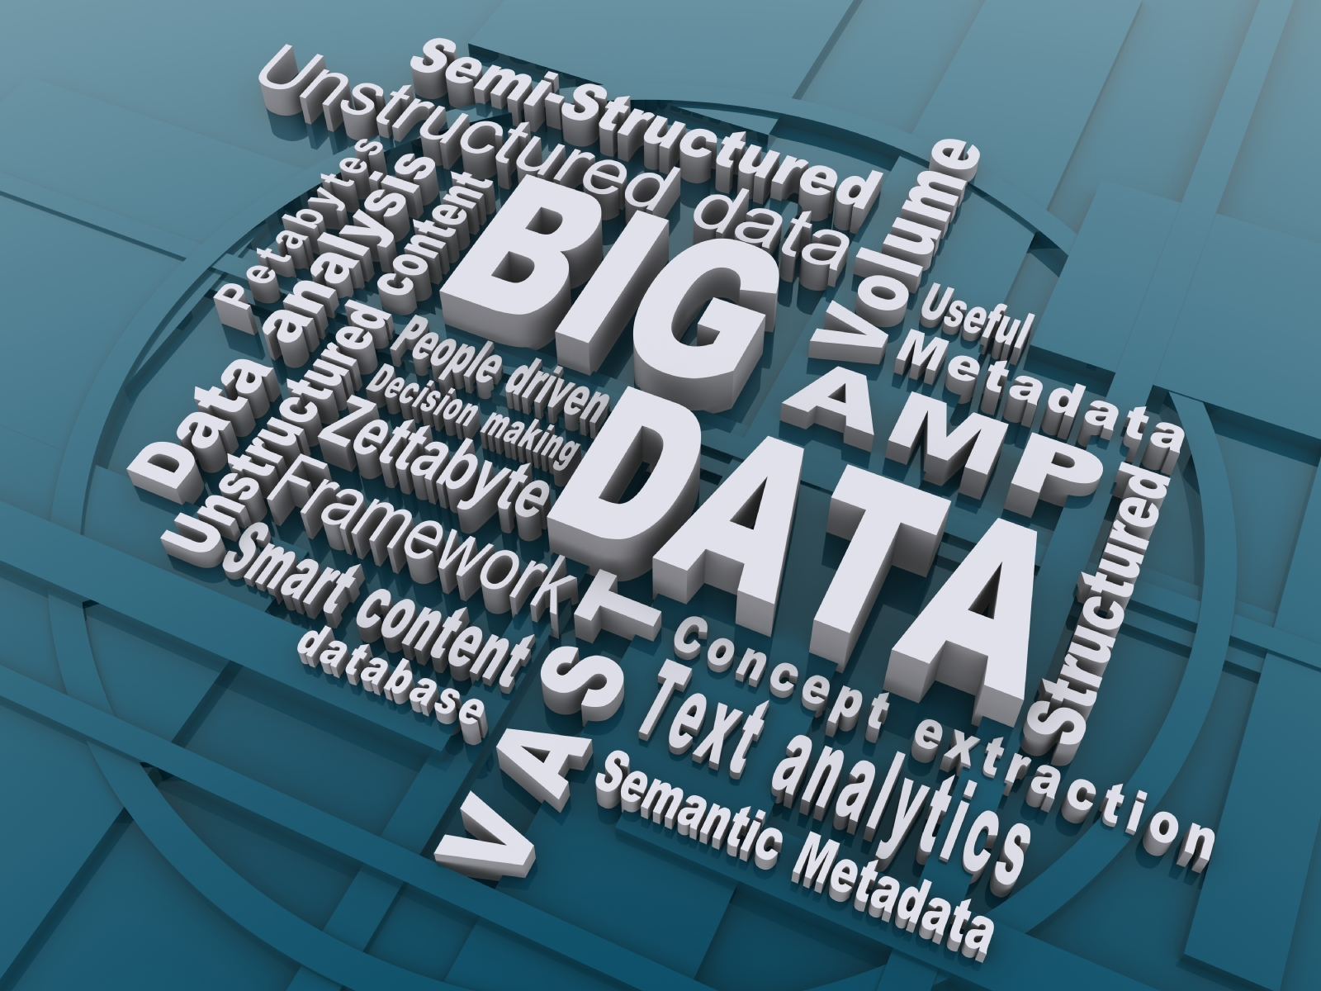
BIG DATA
Prepared By :-
Nisha Choudhary

Slide 2
Content
Introduction
What is Big Data
Characteristic of Big Data
Why Big Data
Tools Used To Analyse Big Data
Application of Big Data
Benefits of Big Data

Slide 3
Introduction
The term Big Data is being increasingly used almost everywhere on the planet – online and offline. And it is not related to computers only.
It comes under a blanket term called Information Technology, which is now part of almost all other technologies and fields of studies and businesses.

Slide 4
What is BIG DATA?
‘Big Data’ is similar to ‘small data’, but bigger in size
but having data bigger it requires different approaches:
Techniques, tools and architecture
an aim to solve new problems or old problems in a better way
Big Data generates value from the storage and processing of very large quantities of digital information that cannot be analyzed with traditional computing techniques.

Slide 5
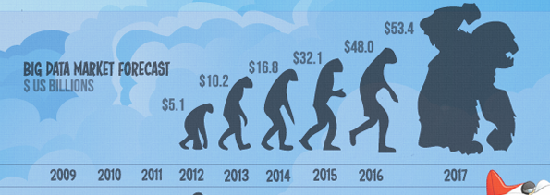
What is BIG DATA
Walmart handles more than 1 million customer transactions every hour.
• Facebook handles 40 billion photos from its user base.
• Decoding the human genome originally took 10years to process; now it can be achieved in one week.

Slide 6
Three Characteristics of Big Data V3s
Volume
Velocity
Data Speed
Variety
Data Types
Data quantity
Notes:
Acco.to IBM
6

Slide 7
1st Character of Big Data Volume
A typical PC might have had 10 gigabytes of storage in 2000.
Today, Facebook ingests 500 terabytes of new data every day.
We currently see the exponential growth in the data storage as the data is now more than text data. We can find data in the format of videos, music's and large images on our social media channels. It is very common to have Terabytes and Petabytes of the storage system for enterprises.

Slide 8
2nd Character of Big Data Velocity
Today, people reply on social media to update them with the latest happening. On social media sometimes a few seconds old messages (a tweet, status updates etc.) is not something interests users.
They often discard old messages and pay attention to recent updates.
machine to machine processes exchange data between billions of devices
infrastructure and sensors generate massive log data in real-time
on-line gaming systems support millions of concurrent users, each producing multiple inputs per second.

Slide 9
3rd Character of Big Data Variety
Big Data isn't just numbers, dates, and strings. Big Data is also 3D data, audio and video, and unstructured text, including log files and social media.
Data can be stored in multiple format. For example database, excel, csv, access or for the matter of the fact, it can be stored in a simple text file.
Sometimes the data is not even in the traditional format as we assume, it may be in the form of video, SMS, pdf or something we might have not thought about it.
Big Data analysis includes different types of data

Slide 10
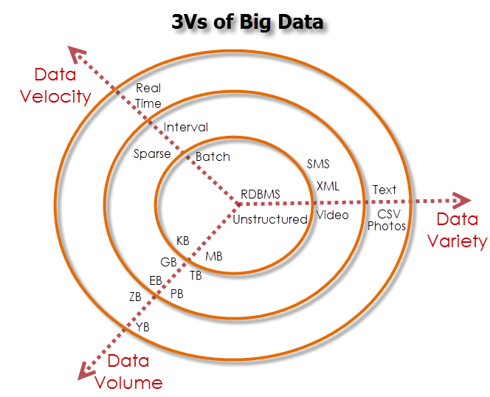

Slide 11
Why Big Data
Growth of Big Data is needed
Increase of storage capacities
Increase of processing power
Availability of data(different data types)
Every day we create 2.5 quintillion bytes of data; 90% of the data in the world today has been created in the last two years alone

Slide 12
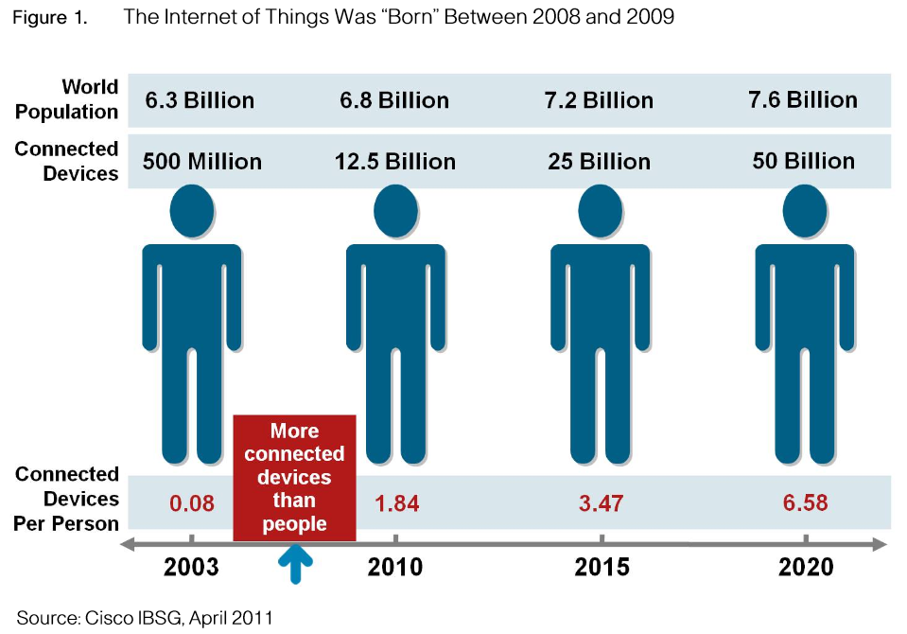
Why Big Data
FB generates 10TB daily
Twitter generates 7TB of data
Daily

Slide 13
Tools Used To Store and Analyse Big Data
BIG DATA is a term used for a collection of data sets so large and complex that it is difficult to process using traditional applications/tools. It is the data exceeding Terabytes in size.
A recent survey says that 80% of the data created in the world are unstructured. One challenge is how these unstructured data can be structured, before we attempt to understand and capture the most important data.
Here are the top tools used to store and analyse Big Data.

Slide 14
Tools Used To Store and Analyse Big Data
Apache Hadoop
2. Microsoft HDInsight
3. NoSQL
4. Hive
5. Sqoop
6. PolyBase
7. Presto

Slide 15
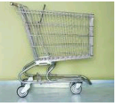

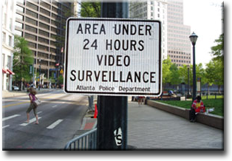


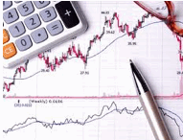
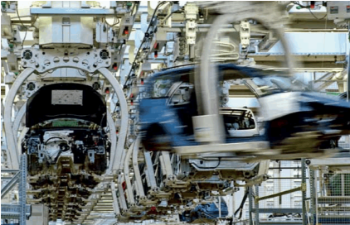

A Application Of Big Data analytics
Smarter Healthcare
Multi-channel sales
Homeland
Security
Telecom
Traffic Control
Trading
Analytics
Search
Quality
Manufacturing
Notes:
Quote practical examples

Slide 16

Benefits of Big Data
Identifying the root causes of failures and issues in real time
Generating customer offers based on their buying habits
Revaluating risk portfolios quickly
Personalizing the customer experience
Adding value to online and offline customer interactions

Slide 17
Thank You.

